Slide 1
Innovation in
The DoD

Slide 2
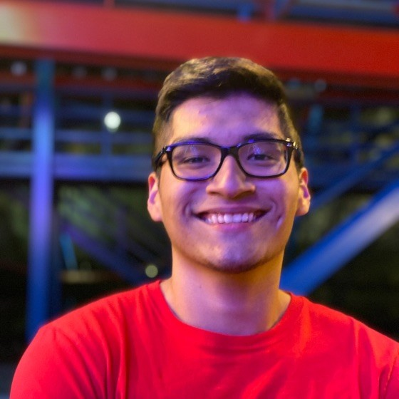
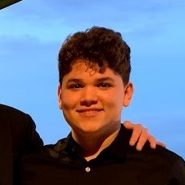

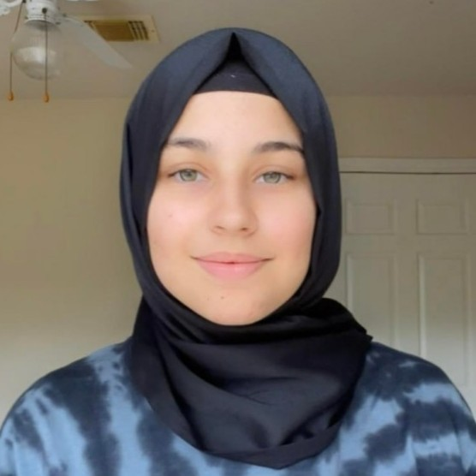
Meet our Team
Luis Alarcon CSCE 22’
Santana Gonzales
ITDE 23’
Juan Perez
ISEN 21’
Mualla Argin
CPSC 23’
Notes:
Hello, we are team #, and our names are: ….

Slide 3

Business Thesis
Our team will create a basket of metrics that the Army Applications Lab can use to evaluate the success of innovation projects

Slide 4
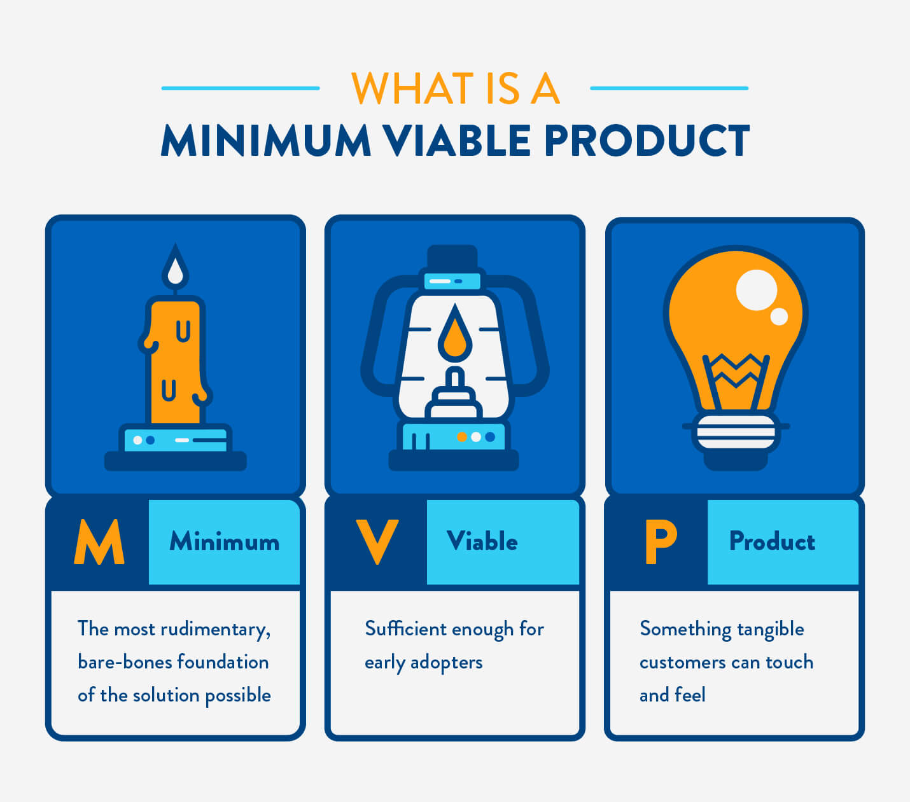
Research
Under 6 month contract
Companies that need a proof of concept
Have the opportunity to continue into MVP
Longer contracts
ALL creates MVP
Company is connected to the DoD

Slide 5
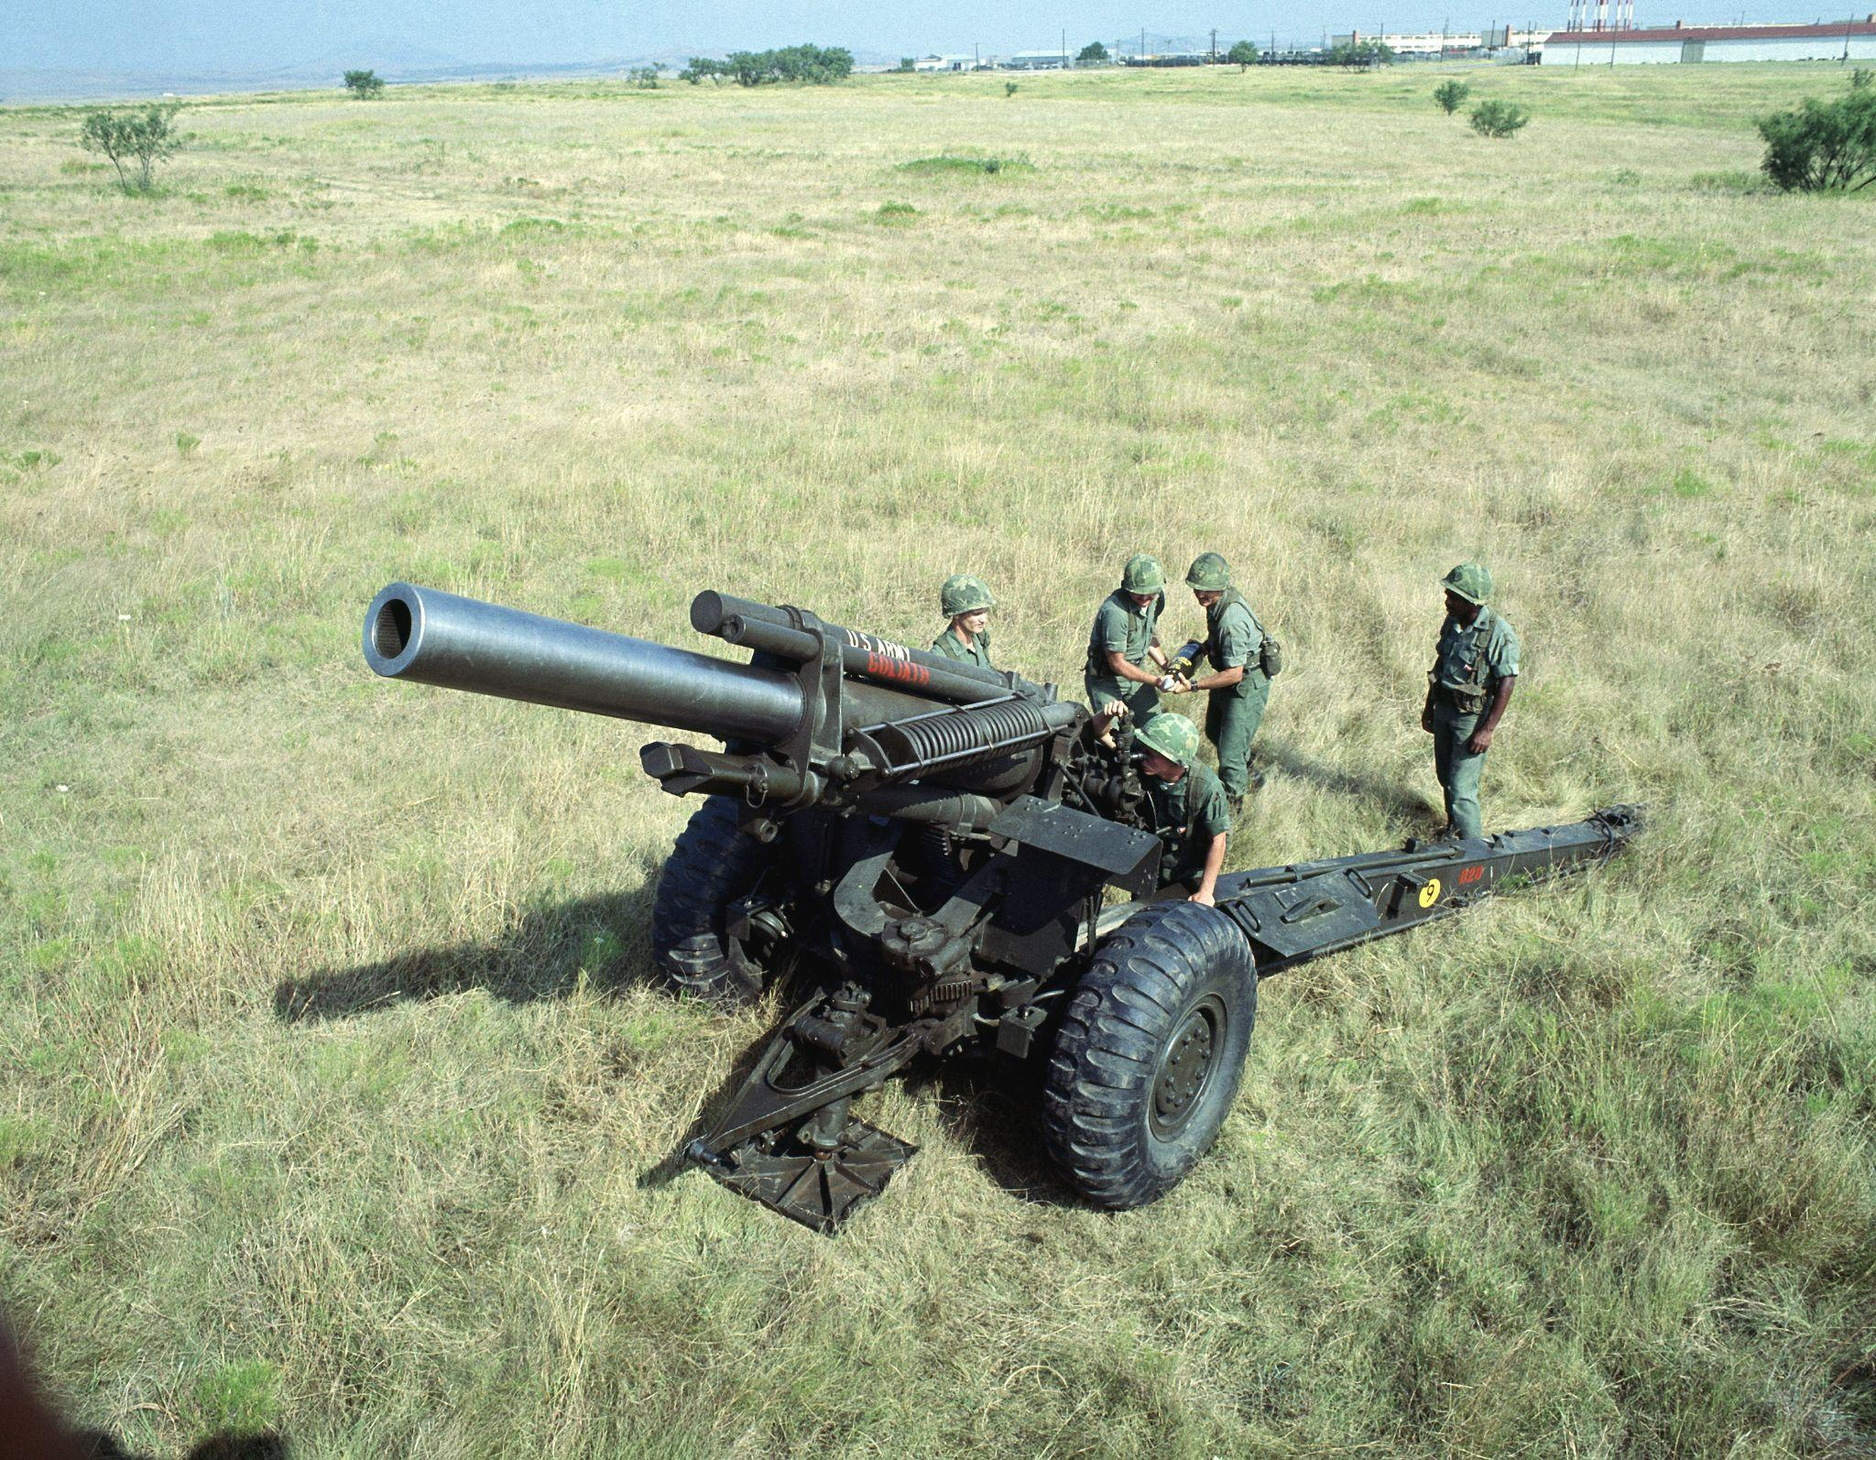
Example project
Cohort
Partnering up with companies in a incubator/hackathon fashion
Fire Faster Cohort
Problem: automating the reloading of a howitzer.
Takes too much man power

Slide 6
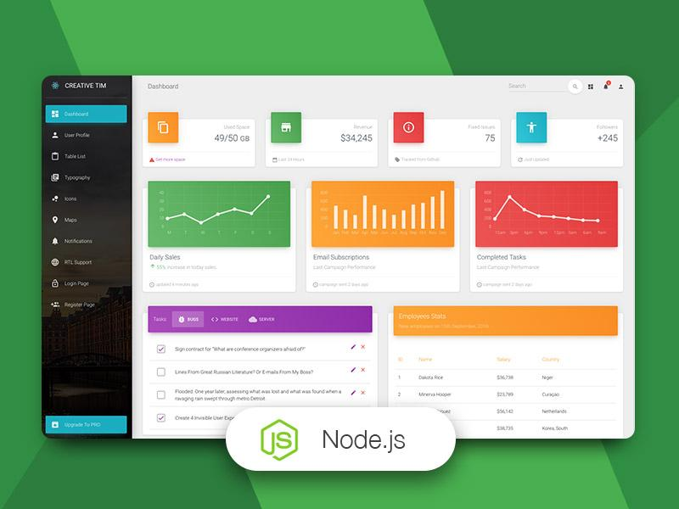
Product Description
Backend and analytics
Taking price, time, products used and comparing them across different projects
Have the opportunity to continue into MVP
Frontend and dashboard
Simple and clear
Key component

Slide 7
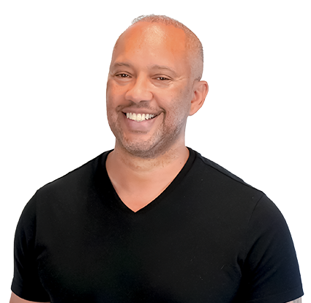
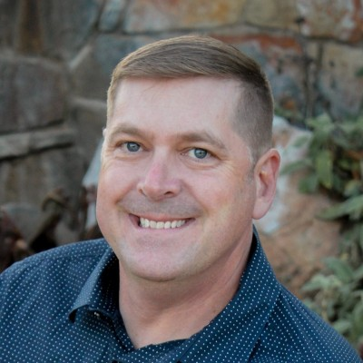
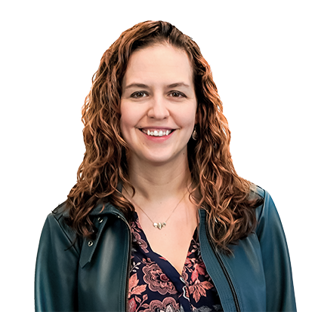
Interviews Conducted
Scott Stanford Eric Pribyla Dr. Casey Perley
Notes:
Interviews conducted

Slide 8
What We Learned
Insights about AAL
Role with the Army
Contracts available through AAL
Insights about our Solution
Possible measures of success
Getting our product started

Slide 9

Market Size
TAM
Total Addressable Market (TAM)
External Startups
Serviceable Available Market (SAM)
Commercial Partners
Serviceable Obtainable Market (SOM)
Internal Army Organizations
SAM
SOM
Notes:
Total Addressable Market TAM (the whole potential market)
Startups like clubhouse can benefit from our innovation metrics dashboard
Serviceable Available Market SAM (reachable market)
Coritech Services (electrical control systems debugging)
Czero (mechanical engineering firm)
Fermata Energy (accelerates adoption of EV)
Serviceable Obtainable Market SOM (local, target market)
Army Organizations like the Army Applications Laboratory

Slide 10
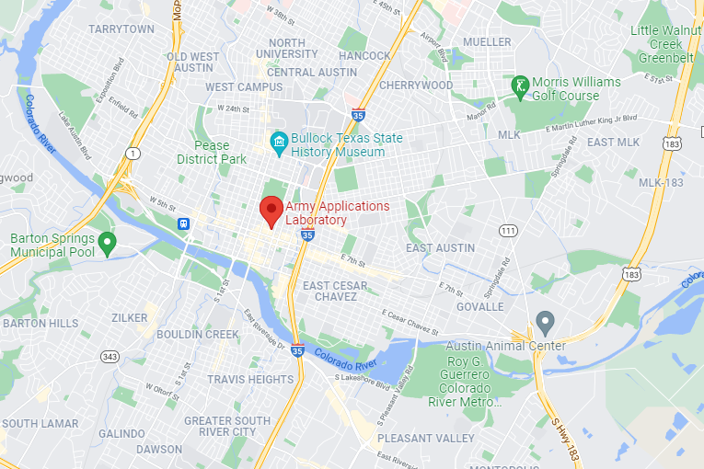
10 Customer Plan
Jim Rabuck
Southwest Regional Director
Andy Riise
University Program Director, Texas A&M University
Texas A&M Faculty
Army Applications Lab
Notes:
How they manage the different projects
How he measures innovation at his position in the National Security Innovation Network & On Campus
Texas A&M Faculty - specifically professors that have work in data science realm (comp sci + stats profs)
We are planning on taking a trip to Army Applications Lab in Austin.

Slide 11
Questions?

Slide 12
References:
https://aal.army/
https://aal.army/what-we-do/
https://aal.army/our-team/

